Slide 1
Workers’ Compensation Loss Estimation due to Earthquakes and Terrorism
Jayanta Guin, Ph.D.
CAS Seminar on Reinsurance
Tarrytown, NY
June 2-4, 2002

Slide 2
Why is AIR Worldwide Modeling Workers Compensation
Prior to 9/11 catastrophe risk modeling was focused on property loss estimates from natural perils
Since 9/11 clients asked us to respond with loss estimates for property and casualty losses due to natural and man-made events
  Primary insurers
  Reinsurers
  Brokers
  Risk managers

Slide 3
What is the State of the Industry
ISO terrorism exclusions approved in all jurisdictions except
  California, New York, Texas, Georgia
  Fire following in statutory fire policy states
  No Workers Compensation exclusions
  Few approvals for Personal Property
Federal legislation is a long shot for the near term
Need to measure/monitor aggregate exposure in an area
  Trophy properties = greater risk
  Adjacencies to trophy properties = greater risk
  Reality of a significant mid-day earthquake
Companies have exposures that are correlated in ways not previously considered

Slide 4
What Are the Rating Agencies Saying?
Many aspects of the business are exposed and correlated
  Multiple lines of business
  Investments
  Operations
  Assumed reinsurance
Management needs to understand the risk and manage exposures quantitatively
Want to ultimately assess all risks, including terrorism, with the same state-of-the-art modeling approach used for natural catastrophes
Exposure data not all currently captured by insurers
  Need to evaluate exposure concentrations

Slide 5
Components of Catastrophe Models
Hazard
Engineering
Loss Estimation
Event
Generation
Intensity
Calculation
Damage
Calculation
Exposure
Information
Insured Loss
Calculation
Validation,
Reporting
Policy
Conditions

Slide 6
Components of AIR’s Workers Compensation Model
Engineering
Loss
Estimation
Damage
state
Damage
state
Damage
state
Damage
state
Damage
state
Damage
state
Damage
state
Building
Information
Damage
ratio
distribution
Damage
state
Injury
Severity
Levels
Loss
Calculation
Number of
Employees
Cost of
injuries

Slide 7
Injury Severity Levels
Injury Classification Scale
Source: HAZUS

Slide 8
Damage States Determine Injury Severity Distribution
Minor
Minor Damage
Moderate
Minor
Life
Minor
Moderate
Damage
Fatality
Moderate
Moderate
Minor
Life
Building
Fatality
Life-
Extensive
Damage
Moderate
threatening
Life
Fatality
Fatality
No Collapse
Complete
Minor
Collapse
Moderate
Life-
Building Damage State
threatening
Injury Rates
Fatality

Slide 9
Calculation of WC Loss for Individual Building in One Event
Minor
Minor
$ Cost
Moderate
Moderate
$ Cost
Total # of Employees in Building
Total Loss
Life-
threatening
Life-
$ Cost
threatening
Distribution
of Total Loss
Fatality
$ Cost
Fatality
Count by
Injury Severity
Cost by
Injury Severity
Distribution of Injury Severity

Slide 10
Occupancy Rates at Different Times of the Day Utilized within the Model
Commercial occupancy rates:
  2:00 p.m.: 98%
  5:00 p.m.: 50%
  2:00 a.m.: 2%
Industrial occupancy rates
  2:00 p.m.: 80%
  5:00 p.m.: 50%
  2:00 a.m.: 10%
Occupancy rates also varies with the day
  Weekday
  Saturday
  Sunday

Slide 11
Total Injury and Loss Distributions
Total Injuries and Fatalities
Total Losses
Number of People
Losses ($ millions)
20
50
100
250
500
1000
5000
10000
20
50
100
250
500
1000
5000
10000
Return Period
Return Period

Slide 12
Workers’ Compensation Model User Input
Employees by building occupancy
Injury cost data by claim severity
Other building specific information
  Construction type
  Building age
  Number of floors

Slide 13
Actual Case Study — Primary Company A
Data received from Primary Company A
  Number of employees per ZIP Code determined by dividing payroll by average salary
  Estimated occupancy distribution
    Initially provided by state
    Provided by ZIP code in subsequent analysis
  AIR occupancy codes translated from WC class codes
  Costs per level of injury
AIR enhancements to data provided
  Construction distribution by occupancy
  Employee distribution by time of day by occupancy type
  Employee distribution by day of week by occupancy type
  Age of building
  Number of stories

Slide 14
Results Provided to Primary Company A —
Injury Counts

Slide 15
Results Provided to Primary Company A —
Loss Estimates

Slide 16
Primary Company B
Data received
  Statewide employee count
AIR enhancements to data provided
  Distribute number of employees to 5 digit ZIP Codes using AIR’s Industry Databases
    Construction type
    Number of floors
    Occupancy type

Slide 17
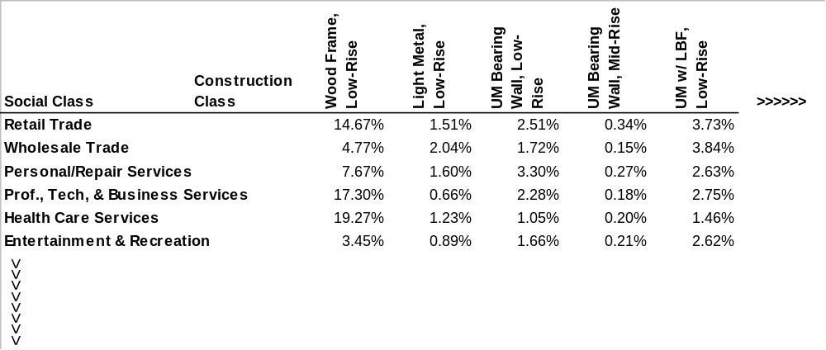
Construction versus Occupancy Type Matrix

Slide 18
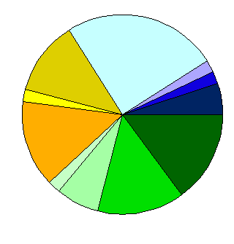
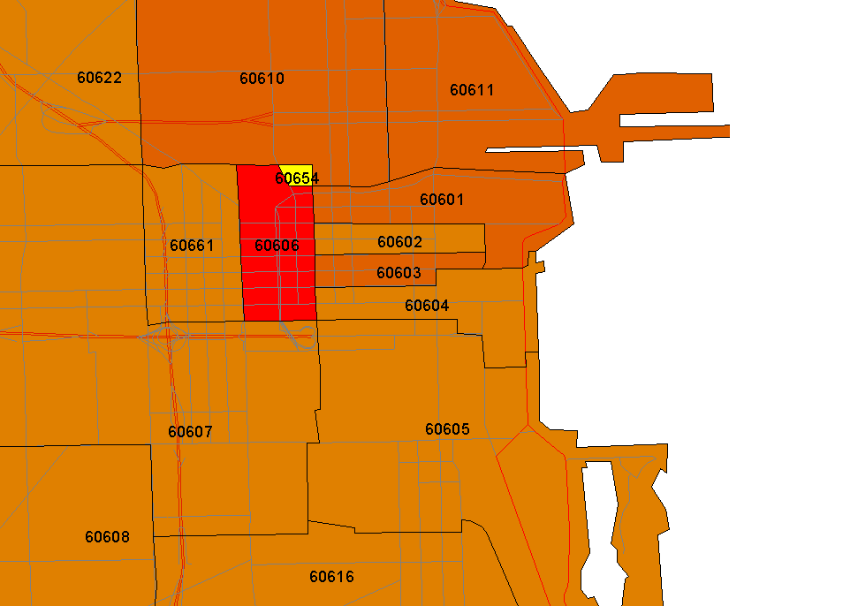
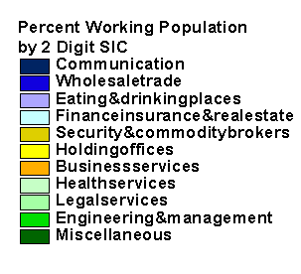
Distribution of Employees by Occupancy

Slide 19
Highlights of AIR’s Workers’ Compensation Model
Workers’ compensation model has coverage for entire mainland United States for both earthquake and terrorism
Incorporates physical damage rather than monetary damage of buildings. Injury and fatality rates are better estimated from physical damage by construction type
It allows user to enter data at several levels of detail
If only aggregate data is available, AIR’s industry databases are used to distribute it to detailed level
Completely compatible with AIR’s earthquake model allowing clients to analyze combined WC and Property losses
Workers’ Compensation CLFs can be generated and imported into CATRADER to analyze WC reinsurance programs

